Slide 1
elastic
search

Slide 2
Sponsors slide (30 seconds)

Slide 3
About Me slide (60 seconds)

Slide 4
Agenda
The “What” & “Why” of Elasticsearch
Quick Start + Search engine basics
Elasticsearch Deep Dive

Slide 5
Agenda
The “What” & “Why” of Elasticsearch
Quick Start + Search engine basics
Elasticsearch Deep Dive

Slide 6

Why Elasticsearch?

Slide 7


Slide 8


Slide 9
Some Considerations
How fast?
Partial Match? E.g. “Apri” matches “April”?
Proximity Search? E.g. “quick fox” matches “The quick brown fox”
Ranking (Scoring)?
Fuzzy Match? E.g. “Chocolite” matches “Chocolate”?
Type-ahead Support?
How well does it scale?

Slide 10
What is Elasticsearch?
NoSQL Database
Full Text Search Engine
REST API
Distributed
Wikipedia: Elasticsearch is a search server based on Lucene. It provides a distributed, multitenant-capable full-text search engine with a RESTful web interface and schema-free JSON documents.

Slide 11
Elasticsearch is…
…a NoSQL full-text search engine based on Lucene.

Slide 12
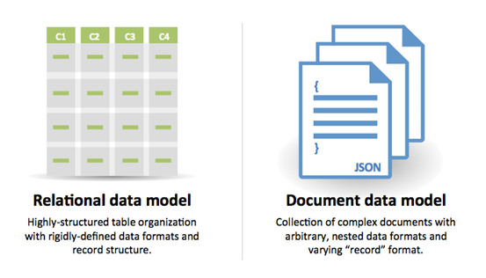
…a NoSQL full-text search engine based on Lucene.
Specifically, it’s a NoSQL Document Database

Slide 13
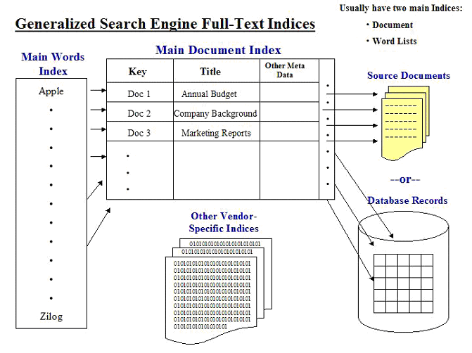
…a NoSQL full-text search engine based on Lucene.
Definition: A search that compares every word in a document, as opposed to searching an abstract or a set of keywords associated with the document using an inverted index.

Slide 14
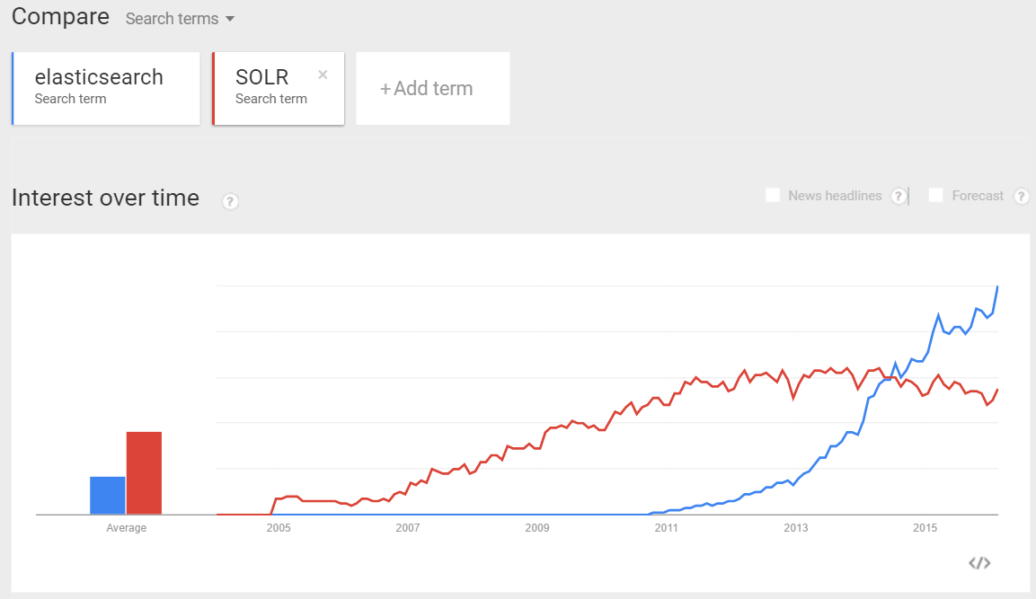


…a NoSQL full-text search engine based on Lucene.
Yonik Seeley
Shay Bannon
https://www.mediawiki.org/wiki/Fulltext_search_engines

Slide 15
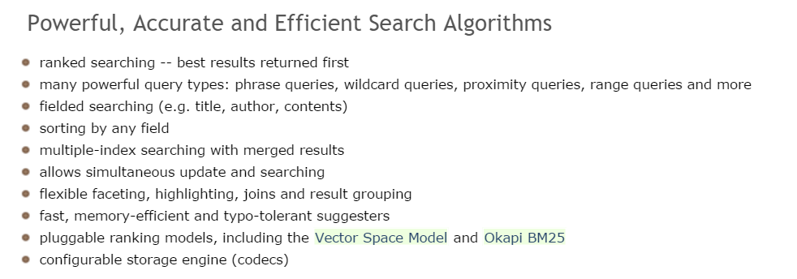
…a NoSQL full-text search engine based on Lucene.

Slide 16
Other Elasticsearch Quick Facts
First public release version v0.4 in February 2010.
Developed in Java, so inherently cross-platform.

Slide 17












Who uses Elasticsearch?

Slide 18
Agenda
The “What” & “Why” of Elasticsearch
Quick Start + Search engine basics
Elasticsearch Deep Dive

Slide 19
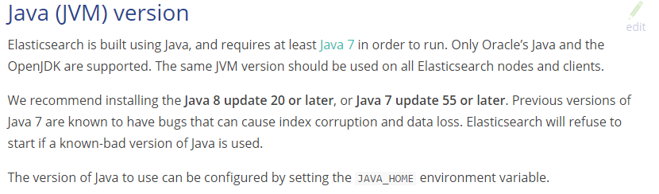
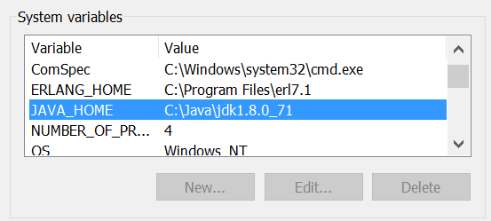
Elasticsearch – Prerequisites for Install

Slide 20
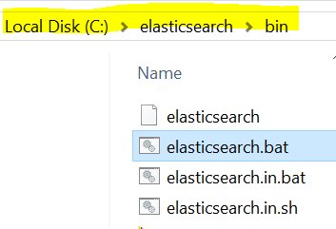
Installation (single node)
Go to https://www.elastic.co/products/elasticsearch
Download and unzip. (e.g. C:\elasticsearch)
Launch elasticsearch.bat

Slide 21
Tools
Curl (command line)
Fiddler (Windows desktop)
Postman (browser)
Marvel/Sense (browser http://localhost:5601/app/sense)

Slide 22
Quick Start, REST (DEMO)

Slide 23
Is It Running?
http://localhost:9200/?pretty
Response :
{
"status" : 200,
"name" : “elasticsearch",
"version" : {
"number" : "1.3.4",
"build_hash" : "f1585f096d3f3985e73456debdc1a0745f512bbc",
"build_timestamp" : "2015-04-21T14:27:12Z",
"build_snapshot" : false,
"lucene_version" : "4.9"
},
"tagline" : "You Know, for Search"
}

Slide 24
Terminology
This Elasticsearch term…
…is like a
Index
Database
Type
Table
Field
Column
Document
Row

Slide 25
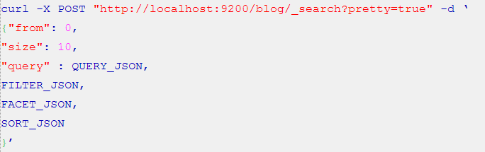
Query DSL (don’t like this example)
The Query DSL is ElasticSearch's way of making Lucene's query syntax accessible to users, allowing complex queries to be composed using a JSON syntax. For example:

Slide 26
Indexing a document (Create)
POST bookshelf/book/3
{
"title" : "Clean Code",
"author" : "Bob Martin",
"pages" : 464 "tags" : ["programming", "software", "architecture" ]
}
Notes:
explain results

Slide 27
Updating a document
PUT bookshelf/book/3?version=1
{
"title" : "Clean Code",
"author" : "Bob Martin",
"pages" : 464 "tags" : ["programming", "software", "architecture" ]
}
Notes:
explain results

Slide 28
Retrieving a document (Read)
GET bookshelf/book/_search
{
"query": {
"match": {
"title": “programmers"
}
}
}
Notes:
explain results

Slide 29
Deleting a document
DELETE bookshelf/book/2
* Delete by Query will be removed in 2.0: it is problematic since it silently forces a refresh which can quickly cause OutOfMemoryError during concurrent indexing, and can also cause primary and replica to become inconsistent. Instead, use the scroll/scan API to find all matching ids and then issue a bulk request to delete them.
Notes:
explain results

Slide 30
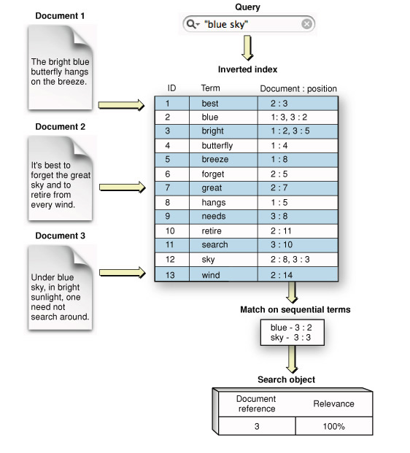
Inverted Indexes

Slide 31
Terminology (cont’d)
This Elasticsearch term…
…is like a
Mapping
Schema
Scoring
Ranking
Analyzer
---
Facet
Aggregation
Aggregation
Aggregation

Slide 32
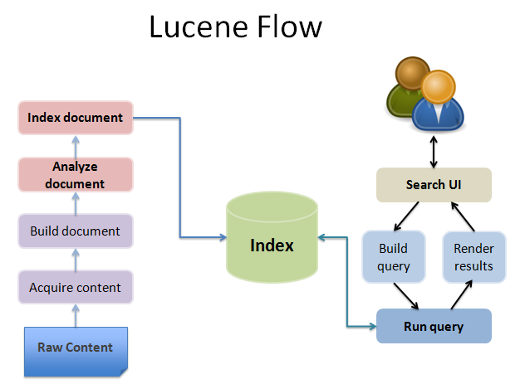

Slide 33
Working with .NET (3 ways)
Raw System.Net way handling httprequest
Elasticsearch.NET
Nest

Slide 34
Two drivers: Elasticsearch.NET or Nest
Just show screenshots of the code difference.

Slide 35
Blog Demo – CRUD Operations

Slide 36
Lucene Searching Theory Maybe?

Slide 37
Scoring/boosting

Slide 38
Highlighting

Slide 39
IMDB Demo - Aggregations

Slide 40
Facets & Aggregations

Slide 41
Real World Considerations
Standalone vs. Part of a System
Elasticsearch PAAS vs. Elasticsearch IAAS

Slide 42
Standalone
Integrated
Web application
Web application
Index new document
Insert new row/ Update row
Search
Elasticsearch
Search for document
SQL DB
Elasticsearch
Sync mechanism
Sync mechanism can be Elasticsearch plugin or your own service

Slide 43
PAAS
IAAS
Web application
Web application
Elasticsearch
Elasticsearch
Node 1
Node 2
Node 3
Nodes & Shards
3
0
2
1
2
1
4
0
3
4
Notes:
The key to understand here is that w/ PAAS your logical and physical layout are the same. For non-PAAS its more complex. But typically you pay a price in terms of $$$ and flexibility with PAAS solutions.

Slide 44
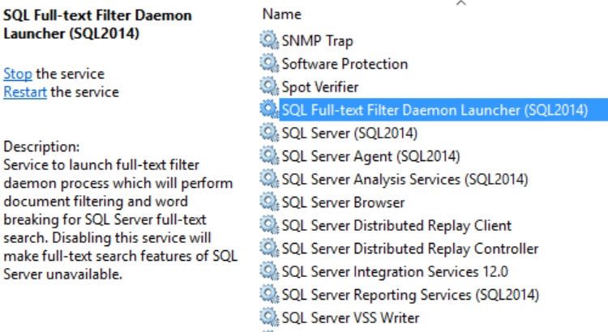
Full-text w/ SQL Server ???

Slide 45
Why not SQL Server?
SQL Server supports full-indexing as well, but there are some limitations/differences:
Full text is only one field per table.
Can only full text search against varchar/text/binary type columns.
Building a Full Text index is extremely I/O intensive (unless starting with little to no data).
It is SQL Server == $$$. Elasticsearch is open source and cost $0 .

Slide 46
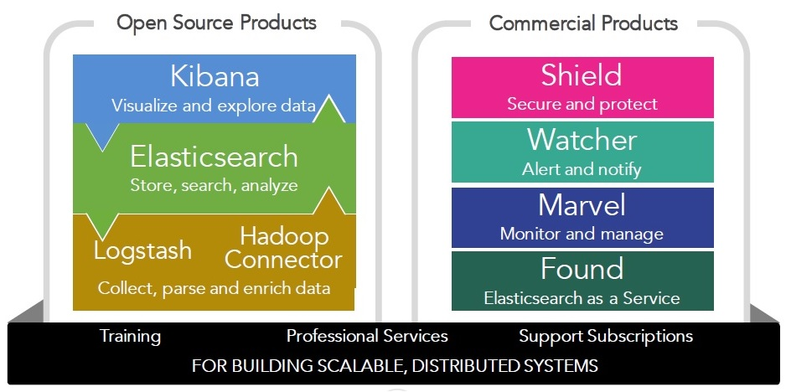
Products
http://www.meetup.com/abctalks

Slide 47
To Summarize:
Elasticsearch = Lucene Search Engine +
Partition Tolerance +
Rest API
Notes:
Purposefully want to cover partition tolerance in a later slide

Slide 48
Summary

